Slide 1
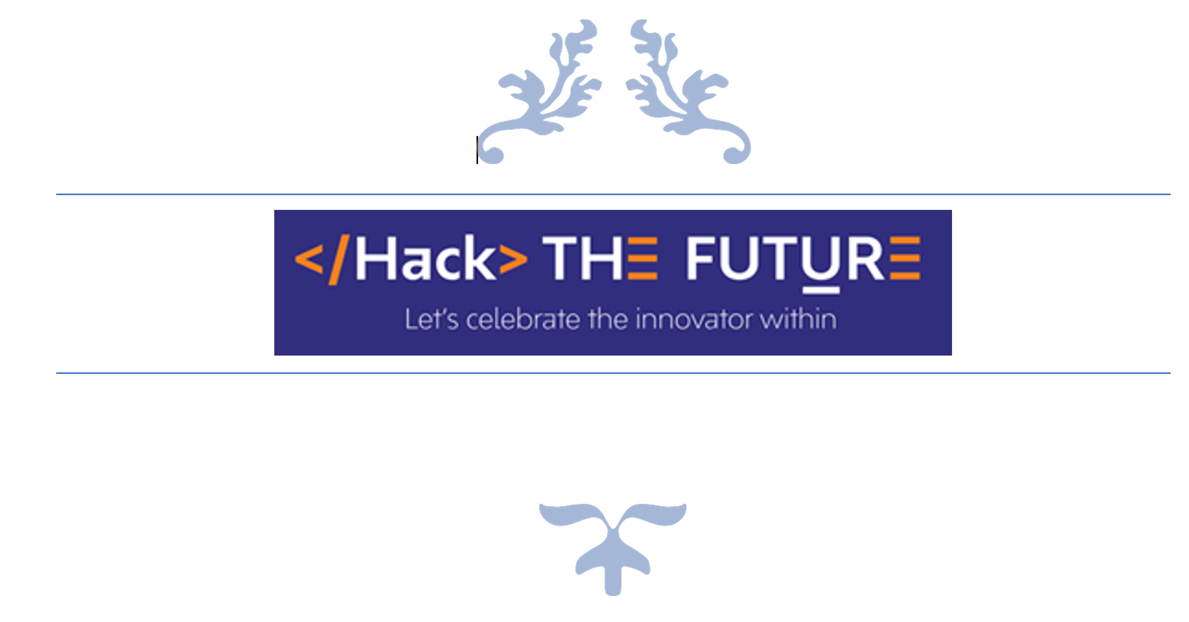


TEAM NAME:
BLUETRON

Slide 2
Problem Statement
Many complicated systems (like Media file processing, Data processing) need their data or process to be in a specific state, or tasks to be running at specific times. While we can use tools like Cron to schedule tasks, the implicit dependencies between different tasks may quickly become unmanageable. By explicitly defining how our tasks depend on each other in the same place you define when they should run, it becomes much easier to work out where something went wrong.

Slide 3
Describe your solution
In the solution approach we are going to dissolve the microservice dependencies while building, deploying and running state of a container holds the microservice runtime.
Suppose we have 3 Microservices and each microservice have a dependency with the state of previous deployment and depending upon the execution status of the previous container’s deployment we may have dynamic deployment dependencies in the pipeline.
In order to solute this we will create a container dynamic workflow engine, where we will create multiple container dependencies and using a workflow counter algorithm, we will resolve the sequential, or parallel execution of dynamic containers for a complex application with event-based scheduling.
Technology Stack used
Tools | Provider
Kubernetes:1.17 | Open Source
Argo : v2.2.1 | Open Source
Java: 1.8 | Open Source
portainer: 2.0.0 | Open Source
Linux: debian, alpine | Open Source
Docker: 19.03.6-ce, build 369ce74 | Open Source
Containerd: 1.3.4 | Open Source
Python: 3.6 | Open Source
Bash: 4.1 | Open Source
Openebs: 2.0.0 | Open Source
Infrastructure Nodes | IBM Cloud Stack / Open Source

Slide 4
Use Cases & Business Value of the solution
Use Cases
Processes/tasks where input for a task depends on the outcome of the previous process and this is true for all the subsequent tasks/jobs in the complete pipelined workflow.
Complex jobs with both Parallel and Sequential steps and dependencies.
Time/Event Based execution of workflows.
Business Value of the solution
For this workflow engine, we have used “Argo” an opensource initiative. Which is a container-native workflow engine for Kubernetes that enables the implementation of each step in a workflow as a container.
It provides simple, flexible mechanisms for specifying constraints between the steps in a workflow and artifact management for linking the output of any step as an input to subsequent steps.
Dynamic utilization of infrastructure resource stacks and allocating it on requirement basis will prune the extra infrastructure provisioning cost.
With the suggested workflow it makes easy to specify, schedule and coordinate the running of complex workflows and applications on Kubernetes. This solution can be heavily utilized for container native platform where CI/CD orchestration is dynamically going to be managed with multiple independent/dependent process stacks and policies.
Using these procedures, we’ll also spend less time setting up new tasks, fitting them into our existing workflows, and spinning up hardware to run them on requirement basis in an auto-scaling topology. Legacy job schedulers with Kubernetes job and wondering how to write sequential jobs as a Kubernetes job.
We can codify the complete CI/CD strategies and organization’s container native PAAS platform with a simple piece of workflow template.

Slide 5
Salient features of Solution
Use Cases
The solution framework provides sophisticated looping, conditionals, dependency-management with DAG’s (Directed Acyclic Graph etc. which facilitates increased flexibility in deploying application stacks and flexibility of configuration and dependencies. With Argo, users can define dependencies, programmatically construct complex workflows, artifact management for linking the output of any step as an input to subsequent steps and monitor scheduled jobs in an easy to read UI.
Resource utilization on requirement basis. Minimizing the resource overhead eventually minimizes the cost for infrastructure provisioning for required containers.
Event based trigger to dynamically schedule containers.
The solution is the best fit for container native CI/CD requirements.
Complete deployment with conditional dependencies can be managed by a simple json/yaml DSL .
Can create various constructs that can be used to deploy streamlined workflows to create complex applications stacks with a very well defined rule-set.

Slide 6
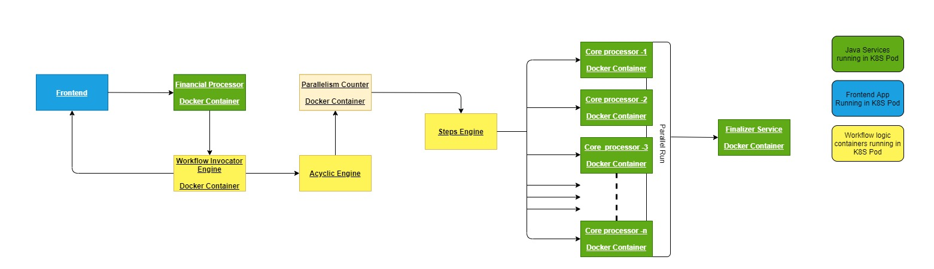
What was accomplished
Solution Architecture Diagram

Slide 7
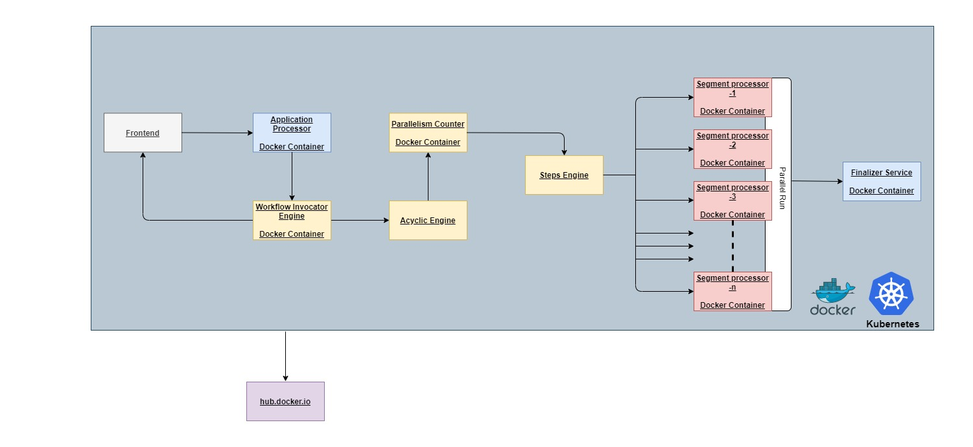
What was accomplished
Solution Flow Diagram

Slide 8
What was accomplished
The solution have a Front End which would be an application running on the Kubernetes pod. The user would provide an input in the form of an excel workbook which may contain numerous sheets. Once the excel workbook with data is added, the Front-end application calls a Java spring boot Microservice and sends the input as excel file.
The Microservice validates the input file and sends the total number of sheets present in the workbook as a response to the front-end application.
The microservice then triggers the workflow engine with the input excel file as an argument to the automation script. The workflow engine counts the number of sheets and depending on that it calls the Kubernetes API to start the workload in Acyclic Engine.
The Acyclic Engine manages the load and the intrinsic dependencies between the process and thereby the containers.
The Parallelism counter starts assigning tasks to the Steps Engine which would eventually create containers to be created dynamically for the workload and should accomplish the job in parallel.
Once these parallel running containers who executed individual piece of task of processing xls to csv gets completed. The merger container comes into place.
The merge container basically merges all the csv to a combined csv file which holds all the processed raw data of input xls file.
The user will be acknowledged with the absolute path of the processed csv files available in the container backed storage.

Slide 9
Challenges & Learnings
Challenges
Identifying the right tool among various available open source solutions like tekton, spinnaker, argo etc.
Identifying the use case how to use hostpath volume with different tools when there is a diversified set of container executors available in the Kubernetes cluster.
Setting up the required applications/tools in the most resource effective manner thereby making the final solution as lightweight and fast as possible.
Creating the lightweight images which would run on dynamic requirement basis.
Integrating shared storage across containers in IBM Kubernetes cluster (Lite account)
Learnings
New tools and policies that can be applied to achieve a container-native solution.
IBM cloud and the various tools and solutions that is available in the cloud environment.
Working with IBM cloud to host our solution.
Possibility of finding solutions to technological problems even in the time of pandemic.
Team coordination and motivation that was achieved despite daily tasks and personal constraints.

Slide 10
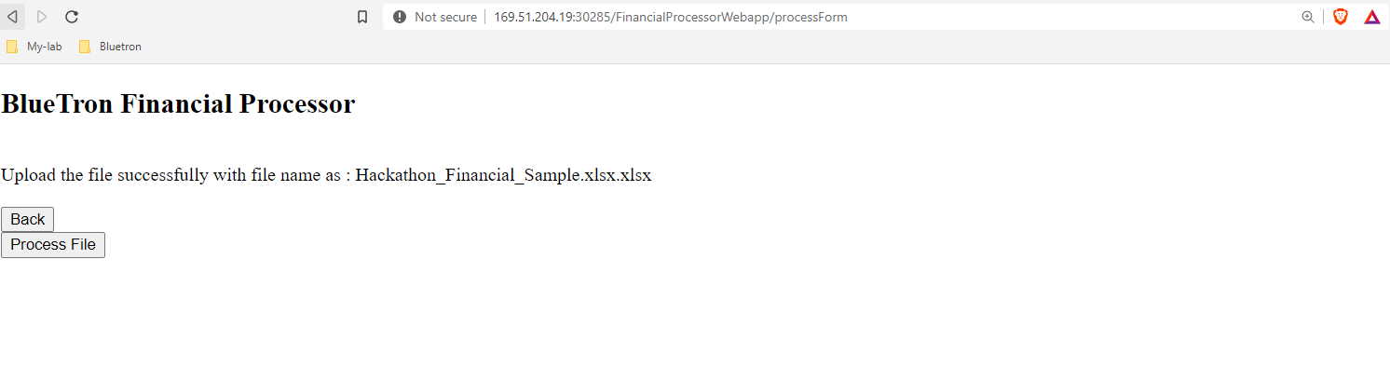
Screenshots(The Frontend)

Slide 11
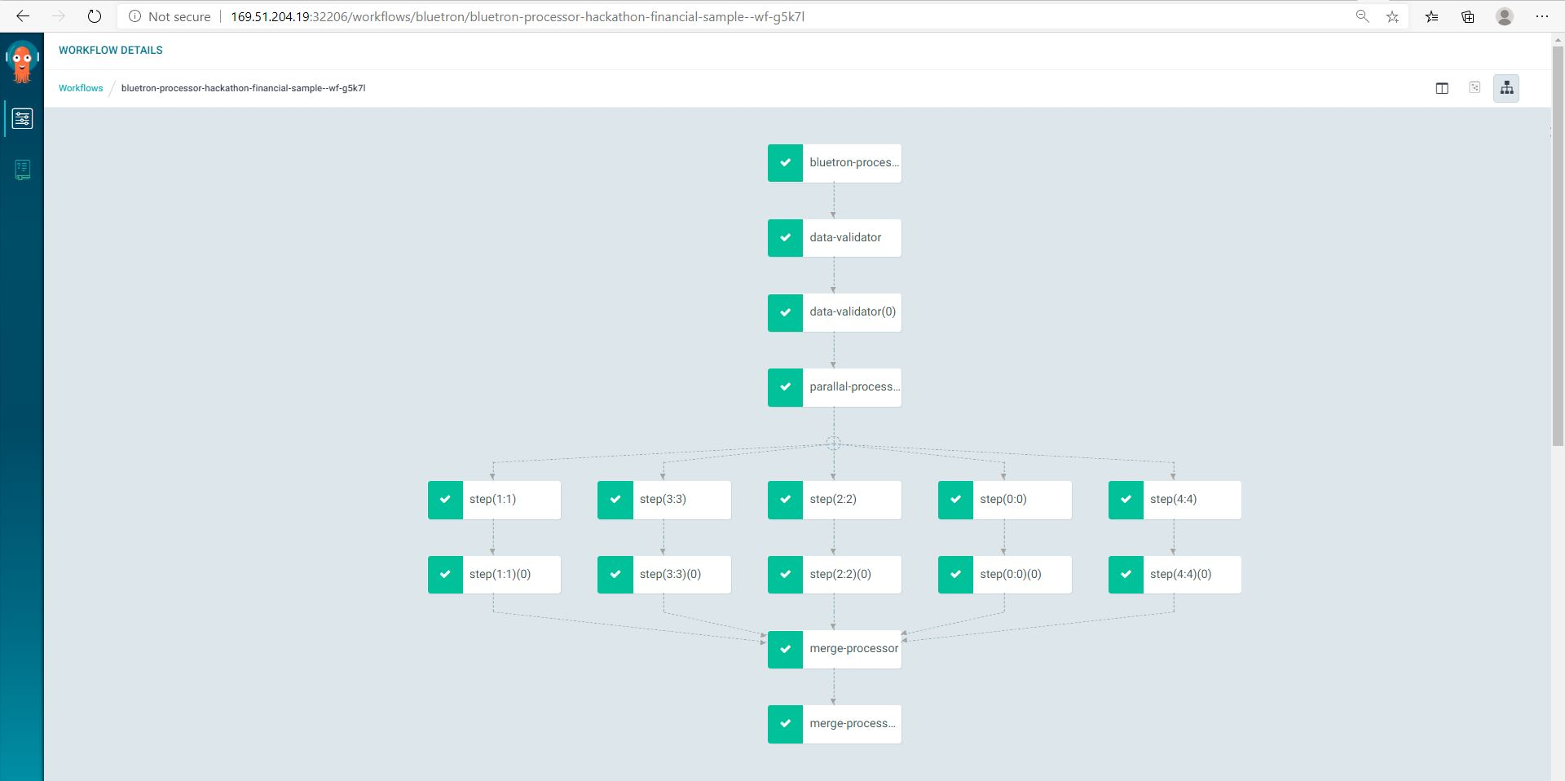
Screenshots(Workflow Process)

Slide 12
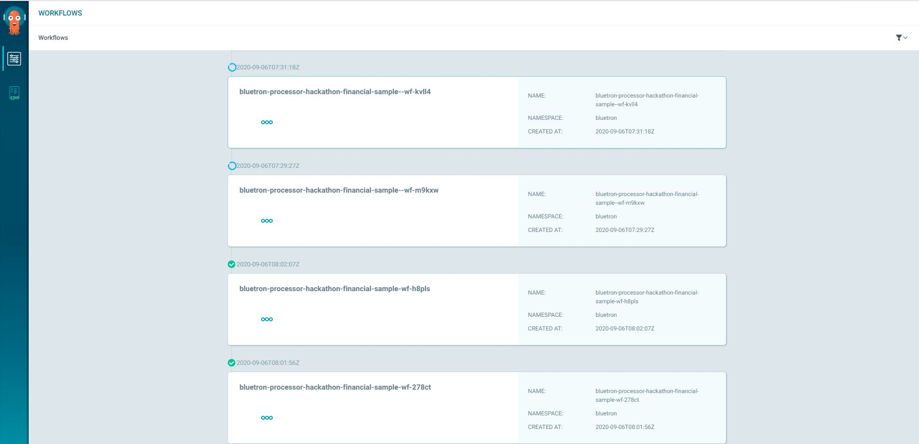
Screenshots(Workflow Dashboard)

Slide 13
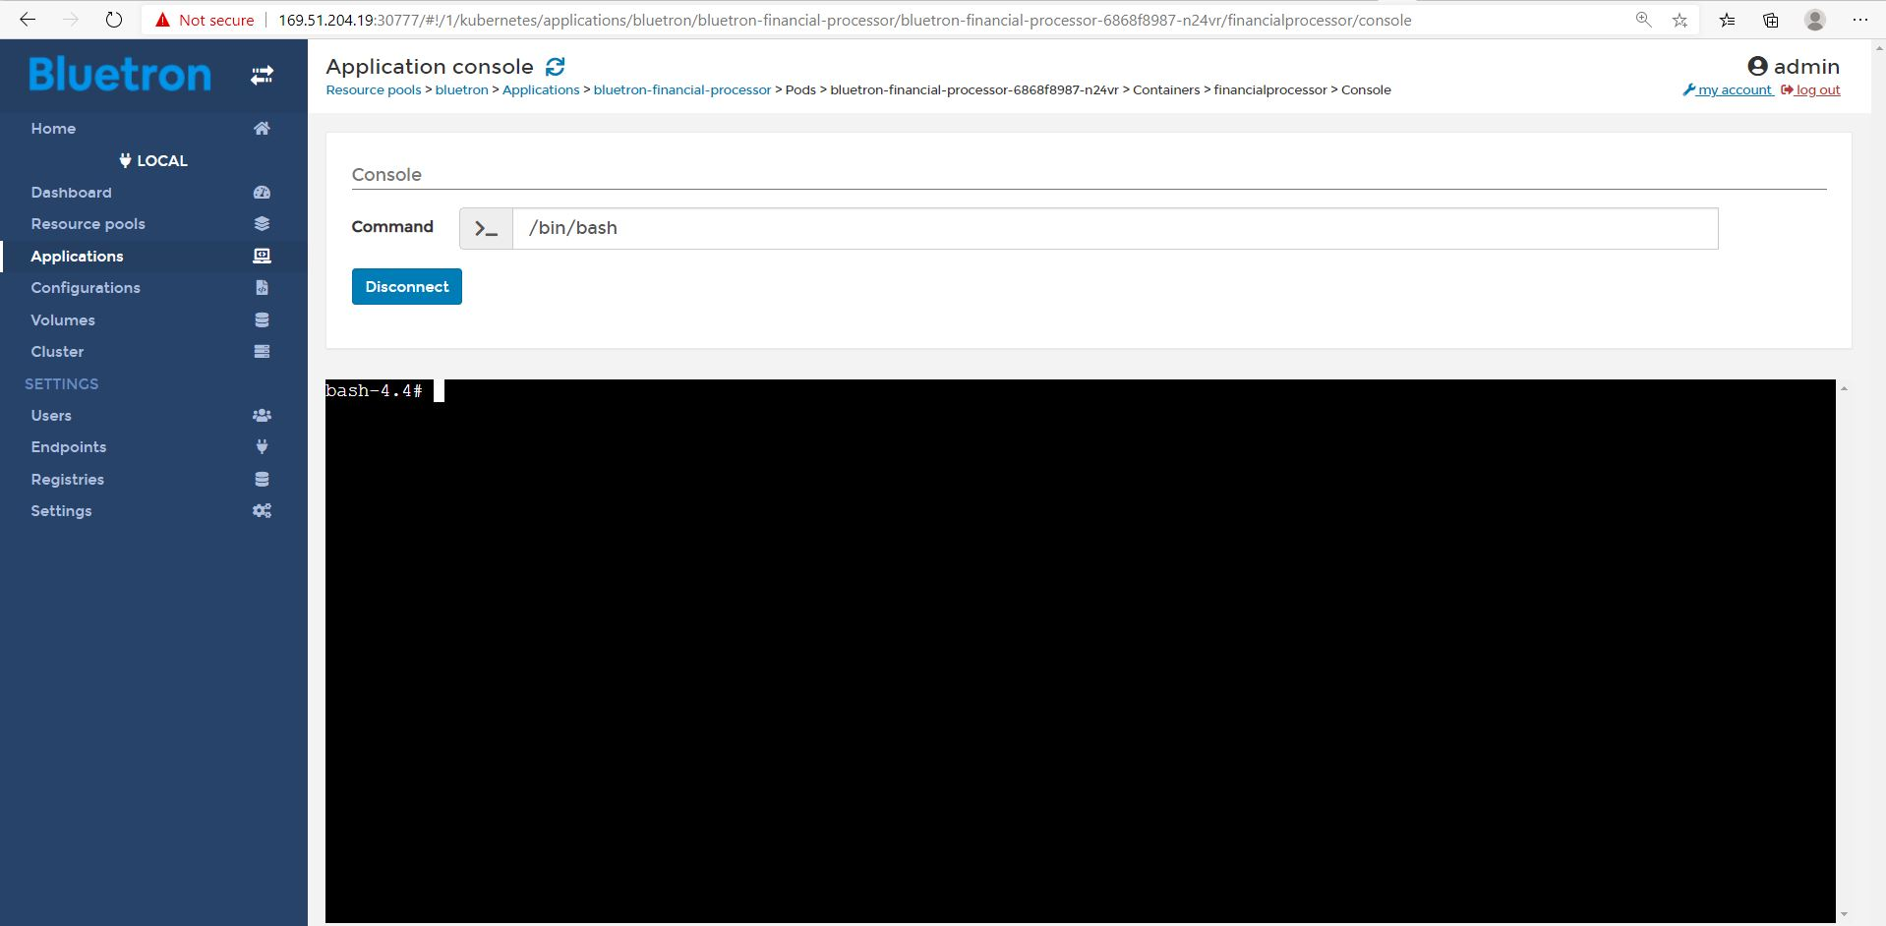
Screenshots(Processor Console)

Slide 14
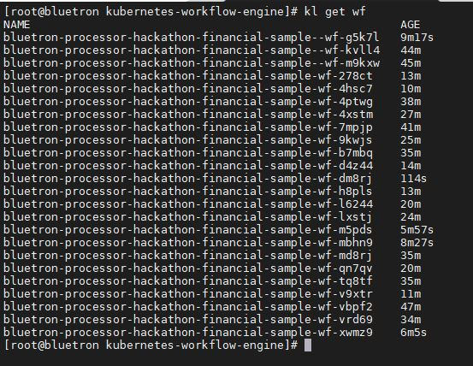
Screenshots(Running Workflow)

Slide 15
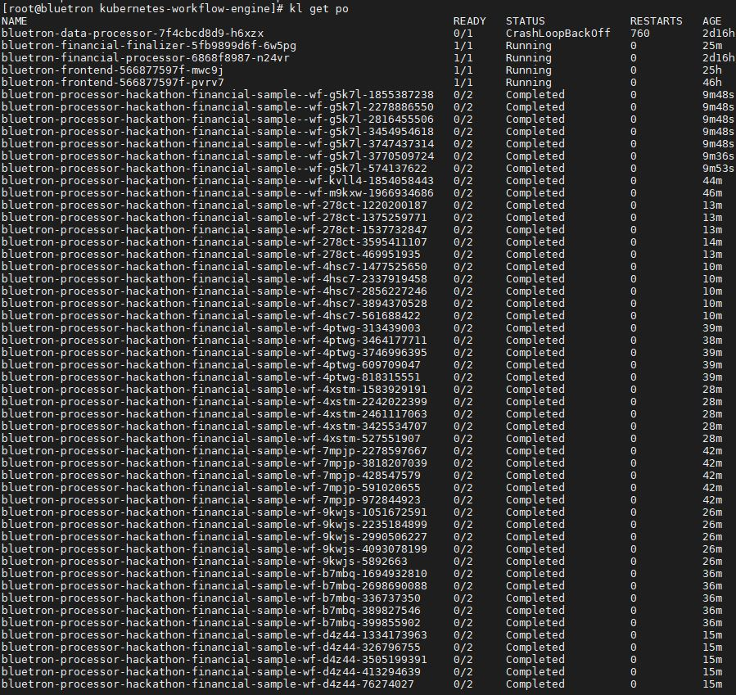
Screenshots(Completed Tasks of Workflow)

